Slide 1
The Humanistic Perspective

Slide 2
The Humanistic Perspective
Disconnected from both Freud, and trait theories.
Humanistic psychologists are not interested in hidden motives or assessing traits
instead they focus on nurturing growth and self-fulfillment.
self determination, self-realization, human potential
NOT the “sick” people
Maslow (1970) and Rogers (1980)

Slide 3
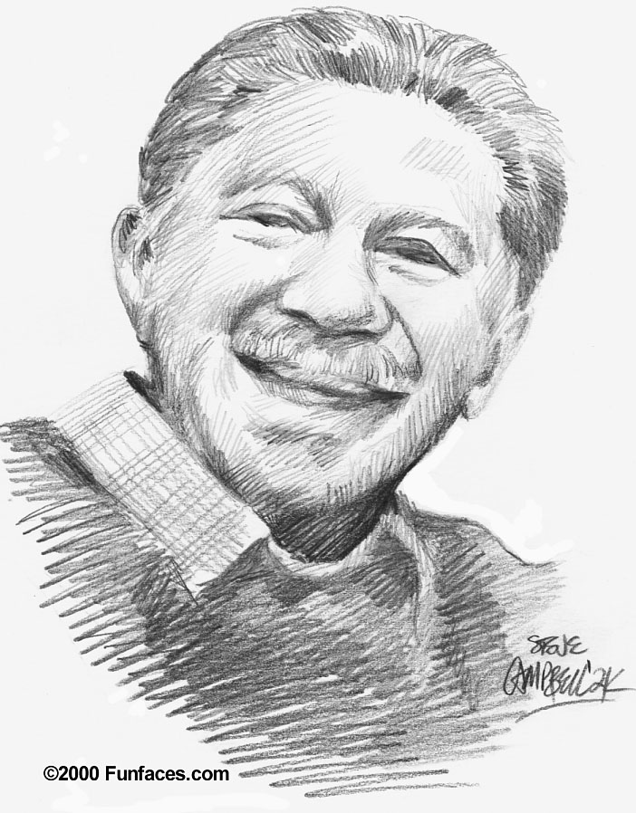
The Humanistic Perspective (Cont’d)
Abraham Maslow (1908-1970) studied self-actualization processes of productive and healthy people.
These people have common characteristics: loving, caring, self-aware, self-accepting, spontaneous, etc.
‘What’s right?’, not ‘what’s wrong?’

Slide 4
Abraham Maslow (cont’d)
Motivated by a hierarchy of needs
Basic physical and psychological needs
food, security, love, etc.
When self-esteem is achieved →
Self-actualization: the ultimate psychological need
it is the need to fulfill one's potential (see Maslow's hierarchy of needs in unit 11, lesson 1).

Slide 5
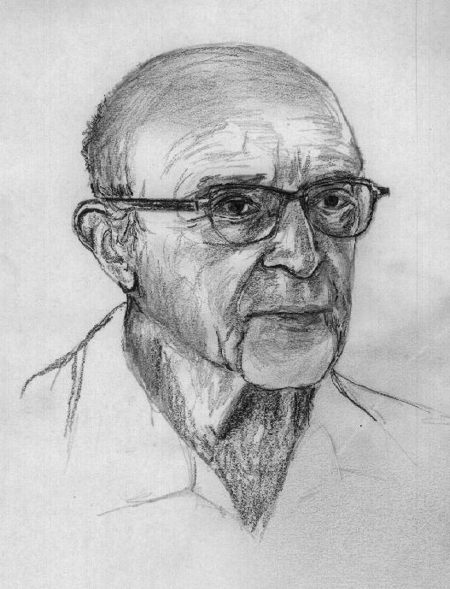
The Humanistic Approach (Cont’d)
Carl Rogers (1902-1987) emphasized people's potential for growth and fulfillment.
Person-centered Perspective
Like Maslow, we are basically good, and have self-actualizating tendencies.

Slide 6
Carl Rogers (cont’d)
The process involving this person-centered perspective required three conditions:
Genuineness
being open (and transparent)
Acceptance
*unconditional positive regard
Empathy
Sharing and mirroring our feelings, and reflecting our meanings

Slide 7
Unconditional Positive Regard
refers to having an attitude of total acceptance toward another person.
Being empathetic requires one to listen carefully and reflectively to another person and to be nonjudgmental.

Slide 8
Maslow meets Rogers…
Both agree that:
a person's beliefs about themselves or their self-concept is central to one's personality.
Assessment techniques include questionnaires regarding one's self-concept.
Research shows that people with high self-esteem (high self-worth) are more likely to be healthier, happier and more accepting of others compared with those having low self-esteem.

Slide 9
The Self
A central feature to our personality is our self-concept
Self-concept: all our thoughts and feelings about ourselves, in answer to the question “Who am I?”
Positive vs. negative self-concept
Real vs. ideal
Self-esteem: one’s feelings of high of low self-worth

Slide 10
How many selves?

Slide 11
The possible selves
Hazel Markus
visions of the self you dream of becoming (rich, powerful, etc)
Visions of the self you fear becoming (unemployed, lonely, etc)
→ Positive visions may lead to positive outcomes

Slide 12
The Self (Humanistic Psychology)
The self (organizer of our thoughts, feelings, and actions) is a pivotal center of our personality.
However, are others really noticing and evaluating us?
“spotlight effect”: the notion that others are concerned with what we do

Slide 13
Culture and Self-Esteem
→ Contrary to common belief, ‘stigmatized’ groups typically do not have lower self-esteem
How?
They value the things at which they excel
They attribute problems to prejudice
Like everyone else, they compare themselves with those in their group

Slide 14
Self-Serving Bias
Self-Serving Bias: a readiness to perceive oneself favorably.
Generally, we accept more responsibility for good deeds and successes than for our failures
Ex. Sport teams, academics
We see ourselves as better than the average Joe
Ex. 90% of business executives rated themselves as more ethical than their counterparts.

Slide 15
Keeping positive perceptions…
We live in a place where “all the women are strong, all the men are good-looking, and all the children are above average”
How do we keep this perception?:
Remember and justify our past actions in self-enhancing ways
Often seek out favourable, self-enhancing info
We overestimate how desirably we would act in situations where most people behave less than admirably.

Slide 16
Culture and the Individual
Our identities are molded in the context of the cultures in which they have developed.

Slide 17
Individualistic cultures
a person gives priority to his own goals over group goals
defines his identity in terms of his own personal characteristics rather than group characteristics.
can move easier between social groups
traveling = enhancing identity

Slide 18
Collectivist cultures:
priority given to the goals of one's group
define own identity according to the group
Family name
Traveling = losing identity
Strong, long-lasting bonds

Slide 19
Evaluating The Humanistic Perspective
“Self-actualization” is vague and lacks objectivity
The emphasis on "self" may promote a lack of concern for others.
Although it is the most optimistic personality perspective, it does not acknowledge human capacity for evil.
→ The humanistic perspective, however, has strongly influenced our ideas on child rearing, education, management, counseling, etc.

