Slide 1
Trait perspective

Slide 2
The Trait Perspective
Trait: a distinguishing quality, characteristic, or pattern of behavior

Slide 3
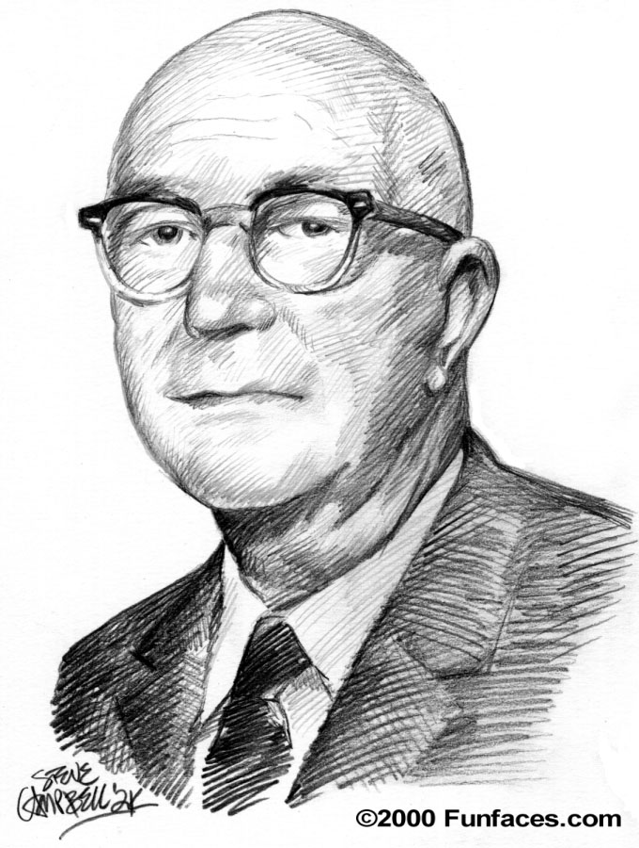
Gordon Allport
Gordon Allport
explained personality in terms of a person's pattern of behaviors, or traits.
conscious motives (unlike Freud)
not reasons for behaviors, but
describing individual traits.

Slide 4
The Assessment of Personality Traits
Personality Inventories
profiles a person’s behavioral patterns
Can assess several personality traits at once
Questionnaires (often with true-false or agree-disagree items)
gauge a wide range of feelings and behaviors.

Slide 5
Minnesota Multiphasic Personality Inventory (MMPI)
The most widely used personality inventory
Assesses several traits at once
An empirically derived test
based on observation or experience rather than theory or pure logic
in contrast to the subjectivity of projective tests, the set of MMPI tests are scored objectively and often by computer.
Notes:
empirically

Slide 6
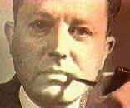
Trait Theories (cont’d)…
William Sheldon
particular body shape = personality type.
the plump endomorph = relaxed and jolly
the muscular mesomorph = bold and energetic
the thin ectomorph = high-strung
and solitary

Slide 7
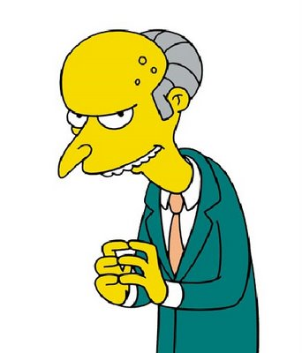
Endomorph, mesomorph, or ectomorph?
*Ectomorph

Slide 8
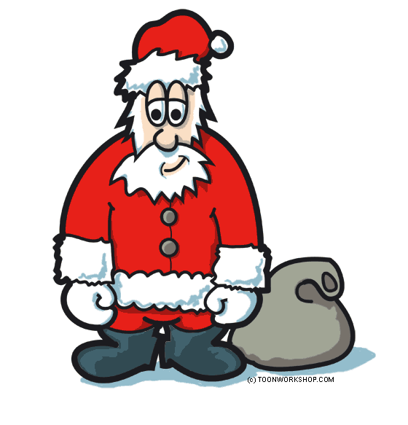
Endomorph, mesomorph, or ectomorph?
*Endomorph

Slide 9
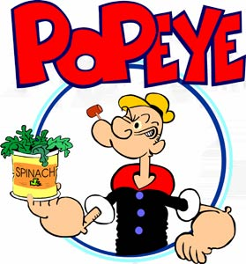
Endomorph, mesomorph, or ectomorph?
*Mesomorph

Slide 10
Myers-Briggs Type Indicator
Isabel Briggs Myers, and Kathleen Briggs
Divides people into ‘types’
Gives the test-taker a choice: ‘Do you usually value sentiment more than logic?’
Categorizes you into ‘types’ based on a variety of answers

Slide 11
Myers-Briggs (cont’d)
Dichotomies
psychological differences into four opposite pairs, or dichotomies
16 possible psychological types
Extraversion → Introversion
Sensing → Intuition
Thinking → Feeling
Judgment → Perception

Slide 12
More Trait Theories…
Hans Eysenck and Sybil Eysenck
Normal individual variations to 2-3 genetically influenced dimensions (pg. 519 chart)
factor analysis: statistically identify clusters of behaviors to identify a particular trait.
Ex. behaviors such as avoiding crowds, preference for solitary activities, difficulty in showing affection, and dreading social events taken together may indicate an introverted personality.
2 main personality factors:
extraversion-introversion
stability-instability
→ varying the combination of these traits produce more specific traits.

Slide 13
The “Big Five” (pg. 519)
Neuroticism (Emotional Stability)
Extraversion
Openness
Agreeableness
Conscientiousness
For instance, one would be considered an extravert if they were affectionate (vs. reserved), talkative (vs. quiet), active (vs. passive) and passionate (vs. unfeeling).
*OCEAN

Slide 14
Barnum effect
Linked to Astrology
Statements that are commonly true for everyone and making them sound specifically descriptive
Ex. Horoscopes → "you are worried about something more than you let on".
Acceptance of such statements as personally accurate is called the Barnum effect.

Slide 15
Evaluating the Trait Perspective
People can fake desirable responses on self-report measures of personality.
However, averaging behavior across several situations seems to indicate that people do have distinct personality traits.
Genetic studies have supported that many traits are biologically rooted.

