Slide 1
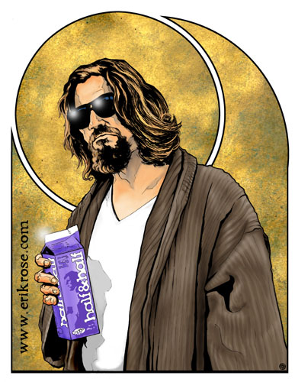
Personality
What will be learned?
Freud
Psychoanalysis
Freudian personality structure
Defense Mechanisms
Neo-Freudians

Slide 2
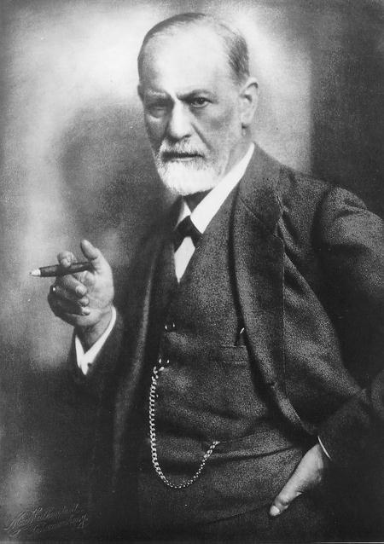
Sigmund Freud
The boring basics:
May 6, 1856 – September 23, 1939
Austrian
Jewish
founded the psychoanalytic school of psychiatry
despite controversy, his ideas still linger…

Slide 3
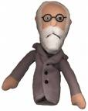
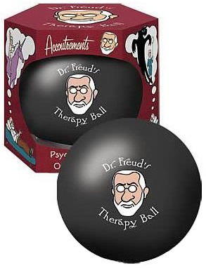
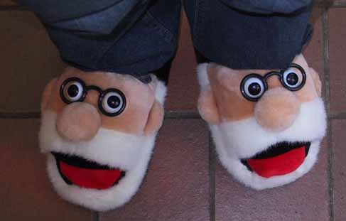
Freud in Pop Culture

Slide 4
Freud
Freud is best known for:
his theories of the unconscious mind
the defense mechanism of repression
for creating the clinical practice of psychoanalysis
dream interpretation
And, without a doubt, his constant references to sex, Sex, SEX!

Slide 5
Freud
Freud is not so known for:
His research (and heavy experimentation) involving cocaine: “On Coca”
Analgesic (painkiller)
Antidepressant
“nasal reflex neurosis“
Got his friend off morphine addiction…
“The Cocaine Incident”

Slide 6
The Psychoanalytic Perspective
childhood sexuality and unconscious motivations influence personality

Slide 7
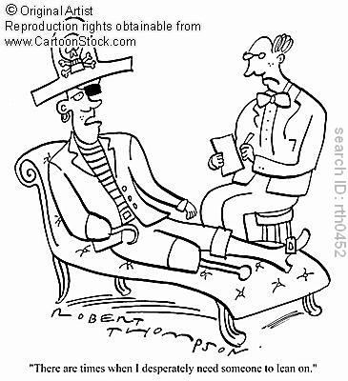
Terms you need to know…
Free Association:
thought diarrhea!
The Unconscious:
information processing of which we are unaware.
Thoughts, wishes, feelings and memories
Access to the unconscious = root of understanding one’s thoughts and behaviors
Preconscious:
information that is not conscious but is retrievable into conscious awareness.
Psychoanalysis

Slide 8
Freudian Personality Structure
Personality arises from conflict:
-Aggressive, pleasure-seeking biological impulses
vs.
Internalized social restraints-
Personality is the result of our efforts to resolve this conflict
-Satisfaction without guilt or punishment-

Slide 9
Three interacting and conflicting systems:
1) ID: strives to satisfy basic sexual and aggressive drives.
"pleasure principle”: seeks only its own pleasure with no regard for logic or reason.
Survive, reproduce, aggress
Ex. a small child wants only immediate gratification
2) EGO: conscious, “executive” part of personality
“reality principle”: strives to satisfy the id's desires in realistic ways
Conscious perceptions, thoughts, judgments, and memories
mediates among the demands of the id, superego and reality.

Slide 10
Three interacting and conflicting systems (cont’d)…
Id, Ego, and the…
3) SUPEREGO: the “voice of conscience” that forces the ego to consider not only the real but the ideal.
How we ought to act
A strong superego may impose guilt and it demands restraint.
A weak superego may be self-indulgent and remorseless.
Life without the Superego: http://www.youtube.com/watch?v=l84MdfAox0Y

Slide 11
Defense Mechanisms
Mental strategies used by the ego to protect itself from anxiety.
Anxiety = the ego losing control of the war between the id and the super ego…
Ex. Mother (super ego), younger sibling (id), and you (ego)
You are the mediator
Defense mechanisms reduce, or redirect anxiety
Keeps anxiety away from the conscious

Slide 12
Defense Mechanisms -Repression-
Repression
Banishes anxiety-arousing thoughts, feelings and memories from consciousness
Underlies all other defense mechanisms
Explains why we don’t remember childhood lust for our mothers (Oedipus Complex)
When repression is incomplete:
"Freudian slips” and dreams

Slide 13
Other Defense Mechanisms…
1) Regression; 2) Reaction formation; 3) Projection; 4) Displacement; 5) Sublimation; 6) Rationalization
1) Regression: retreat to an earlier, more infantile psychosexual stage, where some psychic energy remains fixated (fixation).
Ex. thumb sucking the first day of school (or begging for your mommy the first days of university!)
2) Reaction Formation- occurs when the ego unconsciously makes an anxiety-producing impulse look like its opposite.
People may express feelings that are the opposite of their anxiety-arousing unconscious feelings.
Ex. “I looooooove him” becomes “I HATE him!”

Slide 14
More Defense Mechanisms…
3) Projection- disguises threatening impulses by attributing them to others.
Ex. a cheating husband may be suspicious of his wife and accuse her of being unfaithful. ("The thief thinks everyone else is a thief.")
4) Displacement- occurs when a person "transfers" unacceptable feelings from the appropriate target to a "safer" one.
Do poorly on a test = beat up your little brother

Slide 15
More Defense Mechanisms…(my my, we’re defensive!)
5) Sublimation- unacceptable impulses are redirected toward a more socially acceptable goal
painting a picture or exercising.
6) Rationalization- this occurs when one attempts to justify the reasons for one's actions in an attempt to avoid facing the real, less acceptable reason.
“I failed the test because the teacher sucks!”
*Note: all defense mechanisms function indirectly and unconsciously by disguising our threatening impulses.

Slide 16
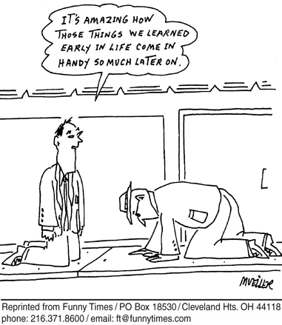
Personality Development “Psychosexual Stages" of development
id's pleasure-seeking energies focus on distinct erogenous zones (pleasure-sensitive areas of the body)
significant influences on personality arise from the unconscious connected to early childhood experiences

Slide 17
Psychosexual stages
Oral (0-18 months): Pleasure focuses on the mouth (sucking, biting, chewing).
Anal (18-36 months): Pleasure involves the control of bowel and bladder elimination
toilet training is usually imposed and the child must cope with demands for control.

Slide 18
Psychosexual stages (cont’d)
Phallic (3-6 years): Pleasure involves the genitals.
Boys: "Oedipus Complex”
Wants mother’s affection, jealous/hatred for father.
Father is dominant (“No, not my penis!”)
Become like father (identification process)
Girls: "Electra Complex”
Penis Envy
Latency (ages 6 to puberty): Dormant sexual feelings and children are busy focusing on social situations and play mostly with peers of the same sex.
Genital (puberty+): Maturation of sexual interests and the development of sexual attraction towards others.

Slide 19
Psychosexual Development (Cont’d)
Maldaptive behaviors in adults result from…
Fixation: a lingering focus of pleasure-seeking energies at an earlier psychosexual stage, where conflicts were unresolved (can occur in the oral, anal or phallic stage)
Ex. Anal: Strict toilet training = anal retentive, neat
Ex. Anal: Lax toilet training = disorganized, messy

Slide 20
Neo-Freudians
Pretty much agreed with Freud, BUT…
Emphasized a conscious interpretation of experience
Interpreting experience, and coping with the environment
Criticized Freud's emphasis on sex and aggression as all-consuming motivators
Placed more emphasis on loftier motives and social interaction

Slide 21
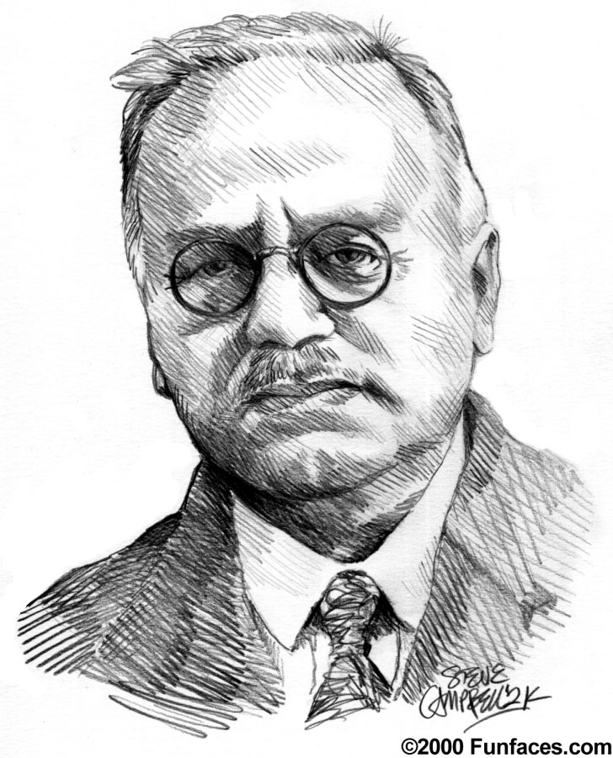
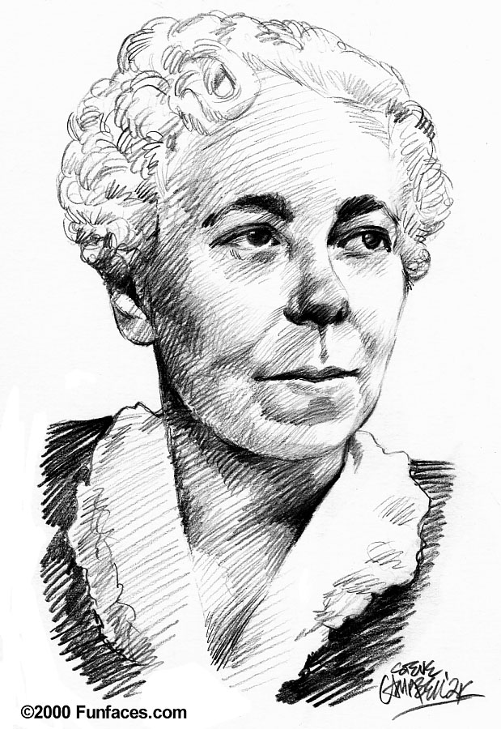
Neo-Freudians…
Alfred Adler and Karen Horney
The importance of childhood is important
But, social, not sexual tensions are crucial for personality development.

Slide 22
Neo-Freudians (cont’d)
Alfred Adler-
much of our behavior is driven by efforts to conquer childhood feelings of inferiority
Feelings that trigger our striving for superiority and power (“inferiority complex”)

Slide 23
Neo-Freudians (cont’d)
Karen Horney-
childhood anxiety is developed a child’s sense of helplessness.
triggers our desire for love and security
sought to balance Freud's masculine biases, and disagreed with his theory of “penis envy”

Slide 24
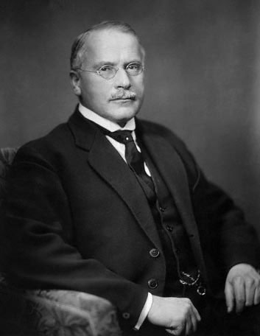
Another Neo-Freudian…
Carl Jung-
Less emphasis on social factors, but agreed the unconscious plays a significant role
the unconscious is more than just repressed thoughts and feelings
emphasized the idea of a collective unconscious
the concept of a shared, inherited reservoir of memory traces from our species' universal history.
Ex. different cultures sharing certain myths and images
Mother as the symbol for nurturance

Slide 25
How do You Assess The "Unconscious" Mind?
Psychoanalysts are not interested in objective tests that assess conscious knowledge
hidden conflicts and impulses!
Projective personality tests attempt to assess the unconscious by providing ambiguous stimuli designed to trigger the projection of one's inner feelings

Slide 26
Projective personality tests
Thematic Apperception Test (TAT)-
people express their inner feelings and interests through the stories they make up about ambiguous pictures.
Rorschach Inkblot Test- (Rorschach from “The Watchmen”)
the most widely used projective test
uses a set of 10 inkblots to identify people's inner feelings by analyzing their interpretations of the blots.
Tests→ Reliability (consistency) and Validity (aim)

Slide 27
Rorschach Inkblot Test
http://en.wikipedia.org/wiki/Rorschach_test

Slide 28
Evaluating the psychoanalytic perspective
Lack good scientific evidence and offer only after-the-fact explanations with no predictive validity.
Developmental psychologists argue that personality development is lifelong and not completed in childhood
Gender identity occurs much earlier in childhood than Freud has suggested and research has shown that gender identity occurs even without a same-sex parent as a role model.
Negative and traumatic events are remembered well (not repressed).
Is repression a myth? (pg. 512)
Shouldn’t we repress traumtic events?

Slide 29
In Defense of Freud…
drew attention to the unconscious
effects of anxiety and our ability to cope with it
our struggle with balancing biological impulses and social acceptance.
language: ego, repression, "anal", fixation, and “having a complex”

