Slide 1
Aquatic & Terrestrial Biomes
Science 1206

Slide 2
Biomes
There are two major types of ecosystems:
Aquatic
Terrestrial
Each can be subdivided further.

Slide 3
Aquatic
Can be subdivided into:
Freshwater
Estuarine
Marine
These are divided based upon their
chemical composition, such as salt
content, also known as salinity.

Slide 4
Terrestrial
Are subdivided into:
Grassland
Forests (boreal, coniferous, etc.)
Tundra, etc.
These are divided based upon the
predominant vegetation, such as grasses or
trees, etc.
These major terrestrial ecosystems are often
referred to as Biomes.

Slide 5
Biomes
A Biome is a large geographical region
that has a particular type of climax community.
In the case of terrestrial (land) biomes, the climax community is defined by the dominant plant species.
The major land biomes are encountered with changes in latitude as one moves from the equator towards the poles. This concept is referred to as latitudinal succession.

Slide 6
Biomes
The key to the concept is to realize that the different lines of latitude receive different amounts of solar radiation, which affects temperature and precipitation.
As one moves over lines of latitude, changes in climate occur that impact the types of organisms to be found in any given biome.

Slide 7
Terrestrial Biomes found in Canada
Tundra
Boreal Forest (Taiga) or the Coniferous Forest
Temperate Deciduous Forest
Grasslands (The Prairies)

Slide 8
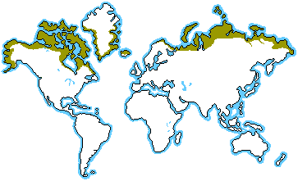
The Tundra
Location:
South of the ice caps of the Arctic extending across North America

Slide 9
The Tundra Climate
Low average temperature.
Average yearly precipitation of 10-12 cm. Due to low evaporation, the region is wet with ponds and bogs during the short, warm summer (poor drainage).
Short growing season of about 60 days.

Slide 10
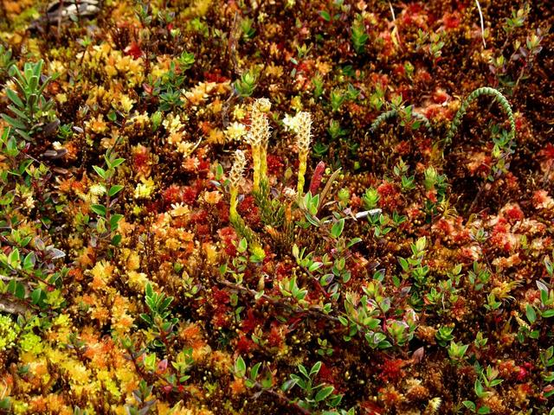
The Tundra Plants
Mosses
Lichens (reindeer moss)
Grasses
Sedges
Shrubs.
The word tundra means
“marshy plain”.

Slide 11
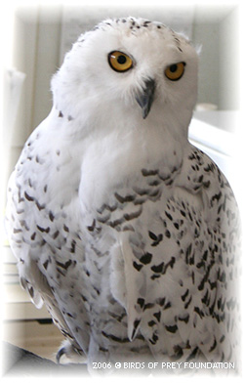
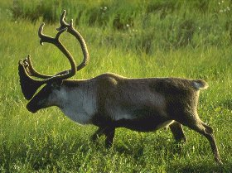
The Tundra Animals
Musk oxen
Caribou
Wolves
Arctic hares
Arctic fox
Lemmings
Snowy owls
Insects include black flies and mosquitoes.

Slide 12
The Tundra Soil
Permafrost (permanently frozen soil) is present.
This makes the growth of large plants impossible.
It ranges in depth from a few inches to several feet.

Slide 13
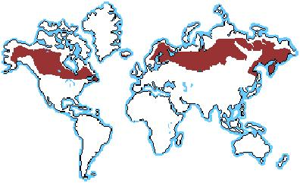
Boreal Coniferous Forest (Taiga)
Location:
South of the tundra extending across North America.
Newfoundland is considered part of the boreal forest biome.

Slide 14
Boreal Forest Climate
Temperature: Slightly higher than Tundra biome, cold winters and warm summers
Average precipitation of 50-100 cm.
Growing season is about 120 days.

Slide 15
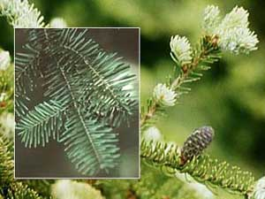
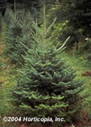
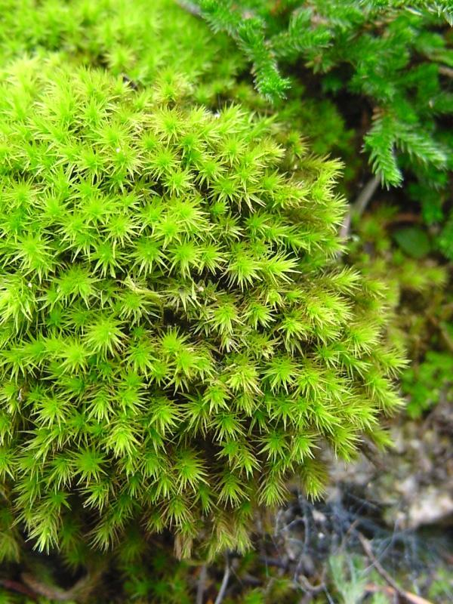
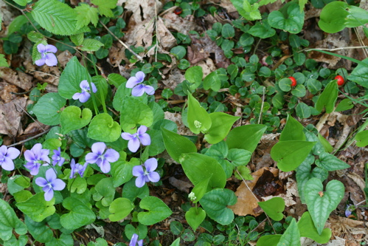
Boreal Forest Plants
Dominated by conifers (pine, fir, spruce)
Some deciduous trees (birch, maple)
Ferns
Moss

Slide 16
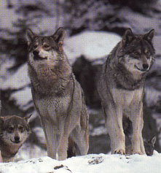
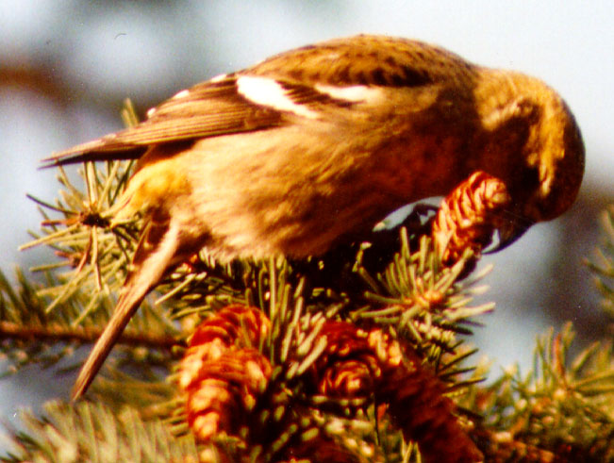
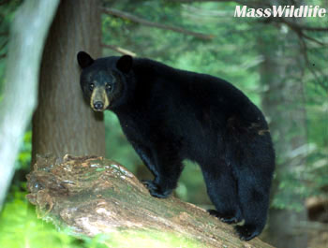
Boreal Forest Animals
Moose, Bears, Marten (Pine martin), Snowshoe hares, Foxes, Beavers
Variety of birds such as warblers (coniferous nesters).

Slide 17
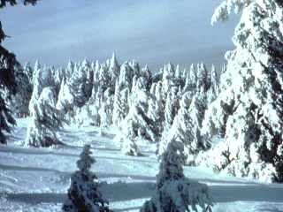
Boreal Forest Soil
Special Features: Soil with no permafrost, a deep litter layer, and is highly acidic.
Acidity due to decay of coniferous leaves which prevents other plants from growing there.

Slide 18
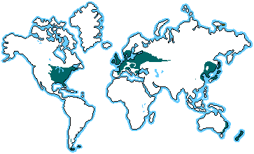
Temperate Deciduous Forest
Location:
South of the boreal forest.

Slide 19
Temperate Deciduous Forest Climate
Temperature: Cold winters with hot summers, higher temperatures than tundra and boreal biomes
Precipitation: 75 to 150 cm of rain a year

Slide 20
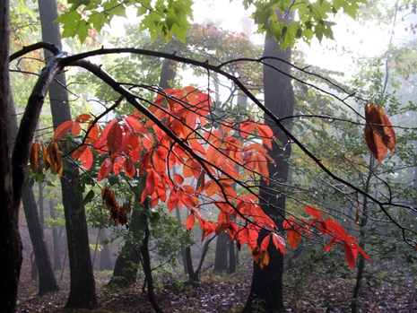
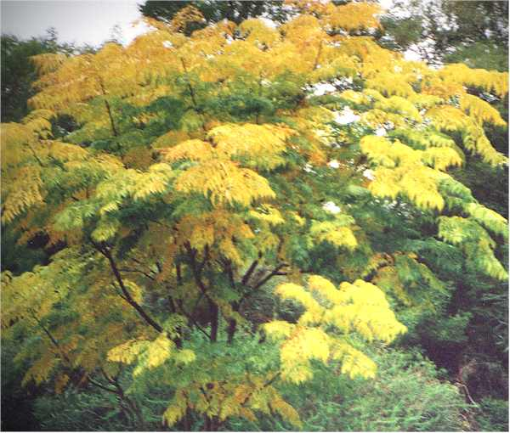
Temperate Deciduous Forest Plants/ Flora
Dominated by deciduous trees (maple, birch, chestnut, beech, oak)
Well developed and diversified shrubs, ferns, moss, etc.

Slide 21
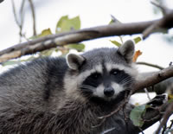
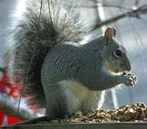
Temperate Deciduous Forest Animals
Animals are abundant and diverse due to greater diversity of plants (black bears, gray fox, squirrels, skunks, racoons, etc.)
Wider variety of birds
Amphibians, reptiles and insects are also abundant and diverse.

Slide 22
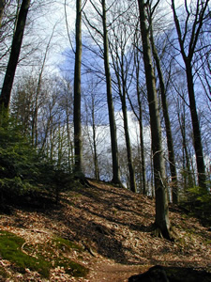
Temperate Deciduous Forest Soils
Special Features: Organic material from fallen leaves provides for richer soils than in boreal forests
Brown soil forests and thin surface litter layer due to rapid decomposition

Slide 23
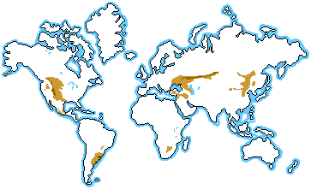
Grasslands
Location:
Canada: Extends from Eastern Manitoba to the Rocky mountains.
Interior of North America.
Usually referred to in Canada as “the Prairies”.

Slide 24
Grassland Climate
Temperatures: Very cold winters with hot summers that cause rapid decay of organic material.
Precipitation: 25 to 75 cm a year, not enough to support trees
Growing season is about 180 days.

Slide 25
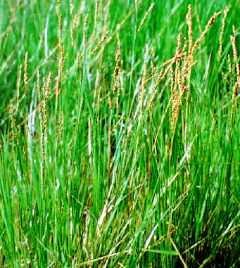
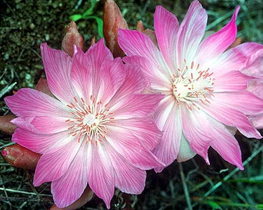
Grassland Plants
Grasses, wild flowers,
trees grow next to rivers, ponds, and lakes

Slide 26
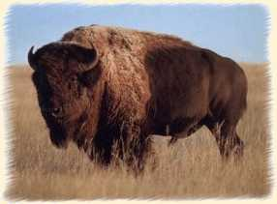
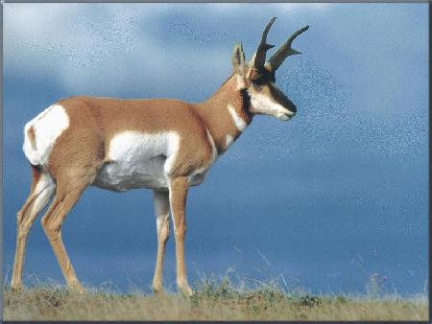
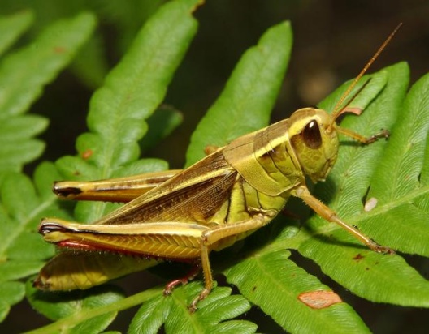
Grassland Animals
Less animal diversity (Snakes, badgers, prairie dogs, ground squirrel, bison were once numerous, etc.
Grassland birds are limited due to the vegetation (sparrows, etc.)
Most abundant insect is the grasshopper.

Slide 27
Special Features:
Soil is deep and rich (fertile) causing this biome to become the most productive farmland on Earth.
Called black earth soil, organic matter accumulates in the upper portion of the soil, making it dark.
Neutral or slightly alkaline soil.

Slide 28
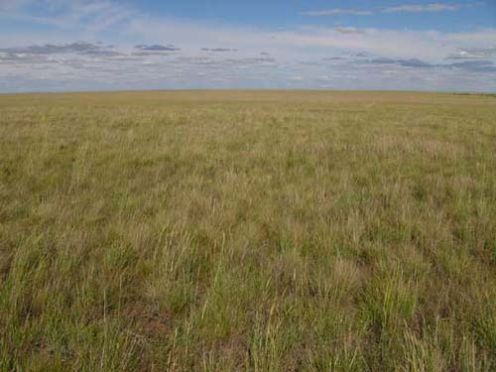
What Biome Does This Region Belong To?

Slide 29
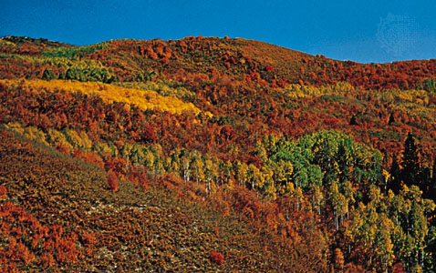
What Biome Does This Region Belong To?

Slide 30
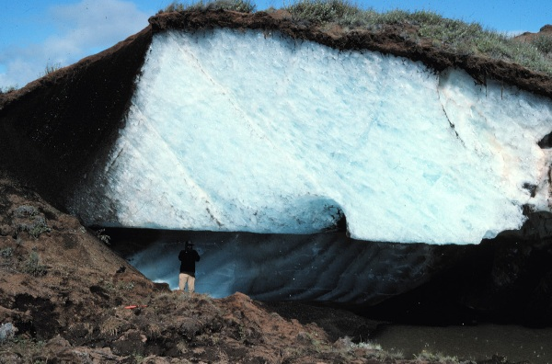
What Biome Does This Region Belong To?

Slide 31
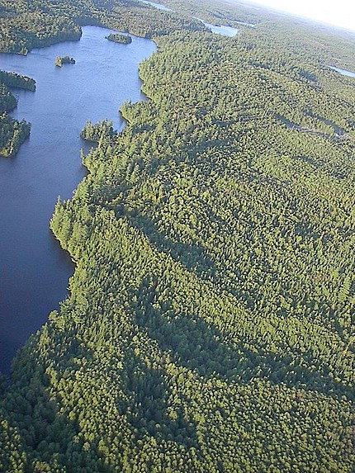
What Biome Does This Region Belong To?

Slide 32
Which Biome has the greatest diversity of plants and animals?

